Slide 1





Network Access Control for Endpoint Devices
Dipendra Ale
ITM4
R00171867

Slide 2
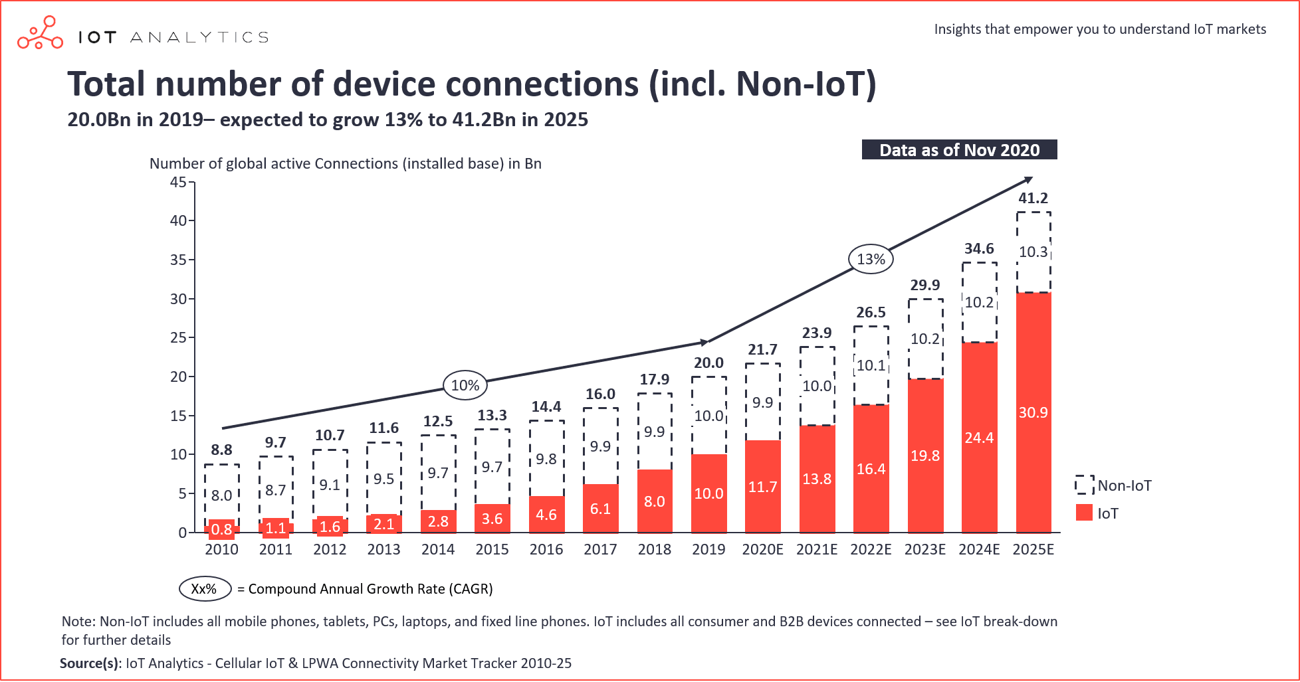
Background
Significant growth in Endpoint device connections
Increasing Importance on Endpoint security
Endpoint devices posed as prime targets for penetration

Slide 3
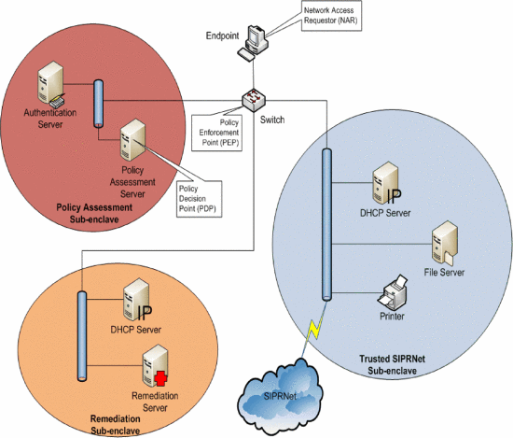
What is Network Access Control?
Unified Security Solution
Provides visibility, access control and compliance for stronger security posture
Utilizes IEEE 802.1x protocol for Authentication and Enforcement

Slide 4
Benefits of using NAC solutions
Improved Network Visibility
Minimize Cyber Threats
Enhanced Network Performance
Cost-effective

Slide 5
Project Goals and Objectives
Investigating features and functionalities of NAC solutions
Configuring and Integrating Open-source NAC solution called PacketFence into a Small-Scale Virtual Network Topology
Provide Comparative Overview of NAC vendors solutions

Slide 6
Project Requirements
Create a sample roles and users to test Authentication and Authorization NAC features
Limit access to the network resources for endpoint devices
Provide DHCP and DNS IP addresses as well as Internet connectivity

Slide 7



Project Implementation
Part 1 : Open-Source NAC Implementation
Part 2 : NAC Vendor Technical Overview

Slide 8
Open-Source NAC Implementation
Phase 1: Installation and Configuration of PacketFence VM
Phase 2: Create sample users with specific roles and access policies within PacketFence
Phase 3: Create a small-scale network topology in GNS3 and integrate PacketFence as a NAC solution for Endpoint devices

Slide 9
NAC Vendors Technical Overview
PacketFence
Cisco NAC
Microsoft NAP

Slide 10
Project Challenges
Gathering of required tools
Learning to use GNS3
Physical Resource Constraints
Integrating Active Directory into PacketFence

Slide 11
Timeline
Installation and configuration of Win Server (AD)
Networking Configuration on Cisco Routers/Switches
Creating roles and users within PacketFence
Gathering Required tools
Improvements and Modification
JANUARY
FEBUARY
MARCH
APRIL
MAY
Testing Phase: Management of Networking Equipment
Testing Phase: Role-based & Guest Access Control
Installation and configuration of PacketFence ZEN
Learning to use GNS3 and building out a small-scale topology
Comparative Overview of NAC vendors solutions

Slide 12
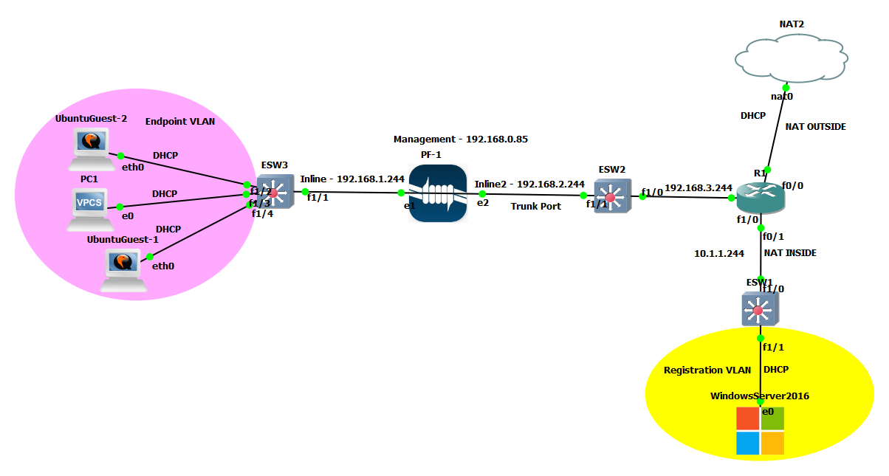
Final Network Topology

Slide 13








Project Testing
Role-Based Access Control
Guest Access Control
Management of Networking Equipment

Slide 14
Project Evaluation
Balance of NAC theory and practical implementation
Increased Project Scope
Improved security posture within Network topology
Learning Curve and Challenges

Slide 15
Project Enhancements
Integration of AD in PacketFence
Integration of Vulnerability Scanner
VLAN Enforcement
Increased Computer Resources
Improved Network Configurations

Slide 16
Project Conclusions
Applicability of PacketFence NAC solution
Other NAC Vendors Solutions
GNS3 Application
Improved knowledge on Networking and Security

Slide 17

Thanks!
Any questions?

